Slide 1
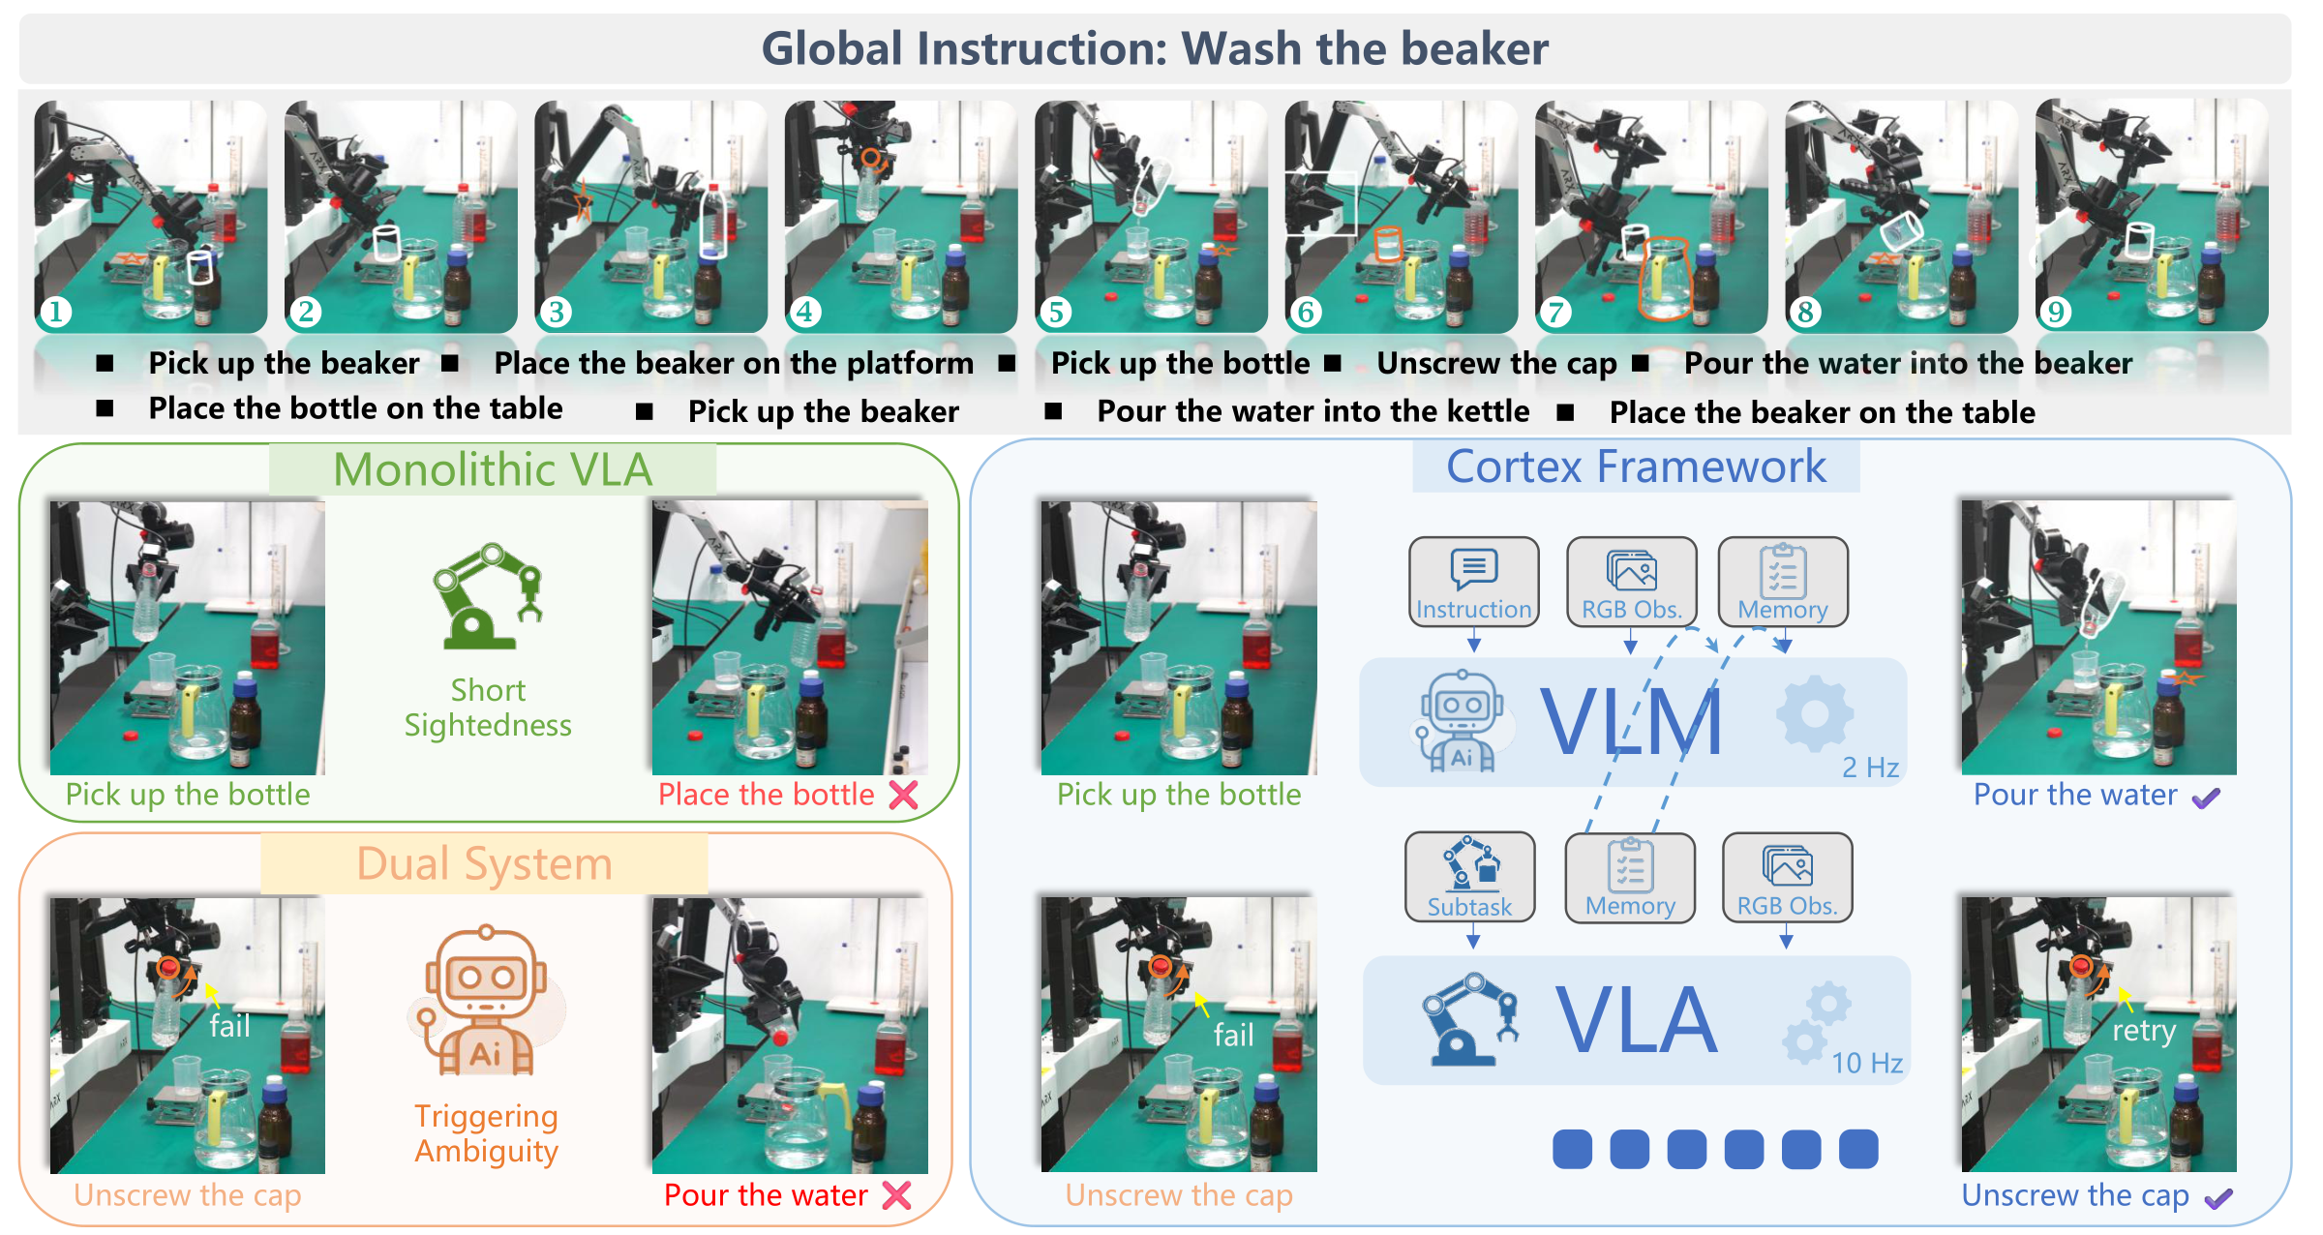
Cortex
A Bidirectionally Aligned Embodied Agent Framework
for Long-Horizon Manipulation
Technical talk deck | 20-25 min
Main thesis
Long-horizon manipulation needs an interface that is both planner-legible and executor-actionable.
CoRL 2026 submission

Slide 2
ROADMAP
02
Talk structure
The story moves from the field-level bottleneck to Cortex's interface, data engine, training, inference, and evidence.
1
Motivation
2
External context
3
Cortex method
4
Evidence
Why long-horizon manipulation breaks reactive VLA assumptions
VLA scaling, skill planners, and memory agents
Interface, metadata, training, inference harness
Open-loop VLM, simulation, real-world robots
0-4 min
4-8 min
8-16 min
16-23 min
Key message
A best-paper-level narrative should make the failure mode, design principle, and empirical evidence mutually reinforce each other.

Slide 3
MOTIVATION
03
Long-horizon manipulation exposes a state-estimation problem
Short-horizon control can be reactive; multi-stage work requires explicit progress verification.
Reactive VLA
Phase ambiguity
Repeated primitives
Similar images may correspond to different logical stages.
Pick/place/pour/press recur with different objects and goals.
a_t = pi(o_t, I)
Current observation plus global instruction is sufficient for many local primitives.
Compounding errors
No success event
One premature transition corrupts downstream execution.
Completion is not a native discrete variable in end-to-end control.
But the task phase is often latent.
Example failure
In beaker washing or chemistry workflows, 'holding the bottle', 'opened the cap', and 'ready to pour' can look locally similar but imply different actions.
Key message
The bottleneck is not only motor control; it is persistent task-state estimation coupled to physical executability.

Slide 4
EXTERNAL CONTEXT
04
Track 1: generalist VLA scaling
Modern VLA models turn robot control into multimodal sequence modeling, but long horizons remain difficult.
RT-2
Octo
OpenVLA
Co-finetunes web-scale VLMs and robot actions; transfers semantic knowledge into control.
Open generalist policy trained across diverse robot datasets with a unified transformer interface.
Open-source VLA model trained on large-scale robot demonstrations for language-conditioned control.
Google DeepMind, 2023
Octo team, 2024
Kim et al., 2024
pi0 / pi0.5
GR00T N1
Flow-style action generation with strong open-world generalization and VLA execution performance.
Foundation model direction for humanoid/generalist robot policies.
Physical Intelligence, 2024-25
NVIDIA, 2025
Cortex view
Scaling the executor helps, but the global instruction still lacks a reliable variable for 'which subtask is active now?'
Primary sources: RT-2 (Brohan et al., 2023), Octo (Team et al., 2024), OpenVLA (Kim et al., 2024), pi0 (Black et al., 2024), GR00T N1 (Bjorck et al., 2025).

Slide 5
EXTERNAL CONTEXT
05
Track 2: hierarchical and agentic planning
Skill-level planners decompose goals, but many are weakly grounded in the downstream executor's physical capabilities.
SayCan
Code as Policies
Recent dual systems
Combines language-model scores with affordance values: 'do what is both likely and possible'.
Uses LLMs to synthesize robot policy code that calls perception and control APIs.
Slow planner + fast executor architectures appear across manipulation and navigation.
Strength: explicit skill choice.
Limit: depends on predefined affordance functions and task-specific skill libraries.
Strength: compositional reasoning.
Limit: brittle when the language plan is not tightly aligned with learned VLA behavior.
Strength: separates reasoning and control.
Limit: the interface is often either too free-form or too latent to verify.
Key message
Cortex inherits the hierarchy, but makes the interface itself an object of data construction, training, and deployment control.
Primary sources: SayCan / Do As I Can, Not As I Say (Ahn et al., 2022); Code as Policies (Liang et al., 2023).

Slide 6
EXTERNAL CONTEXT
06
Track 3: memory and long-horizon evaluation
Memory helps, but passive history storage does not automatically become actionable task state.
Memory-augmented VLA
Benchmarks
Cortex distinction
Visual buffers and short-term memory reduce some local repetition, but context windows and raw tokens are not a structured progress variable.
LIBERO tests knowledge transfer and long tasks; RoboTwin stresses bimanual manipulation; RMBench targets memory-dependent tasks.
Memory is compressed into subtask-level milestones and updated only at verified transition events.
Representative direction: MemoryVLA and related embodied memory systems.
These benchmarks reveal errors that are invisible in isolated primitive evaluation.
The planner is not asleep during execution; it continuously verifies progress.
Key message
The relevant memory is not 'more frames'; it is a physically grounded, updateable state abstraction.
Primary sources: MemoryVLA (Shi et al., 2025); LIBERO (Liu et al., 2023); RoboTwin 2.0 (Chen et al., 2025); RMBench (Chen et al., 2026).

Slide 7
POSITIONING
07
The missing link: bidirectional alignment
A high-level planner must respect low-level capability, and the executor must receive stable, phase-correct commands.
Top-down alignment
Bottom-up alignment
Interface contract
System-2 should output subtasks that System-1 can actually execute.
System-2 should update memory only when execution evidence supports it.
The subtask is not a prompt trick; it is a shared representation across data, training, and deployment.
Requires: canonical skills, templates, object attributes, reachability-aware routing.
Requires: transition supervision, semantic patience, asynchronous progress verification.
This is Cortex's central design object.
Key message
Cortex reframes long-horizon manipulation as interface alignment, not only as policy scaling.

Slide 8
CONTRIBUTIONS
08
Cortex in one slide
The framework couples a cognitive orchestrator with a reactive executor through a standardized, executable subtask interface.
1
Bidirectionally aligned interface
Subtasks s_t plus semantic memory M^(t) bridge high-level planning and continuous control.
2
Scalable metadata construction
4k+ hours of annotated open-source/real videos plus 30h simulation generation.
3
Event-balanced training
The VLM learns both semantic patience and boundary-triggered memory update.
4
Asynchronous deployment harness
Skill constraints, command matching, command holding, and timeout recovery stabilize real robots.
Key message
The contribution is the co-design of representation, data, training, and online control.

Slide 9
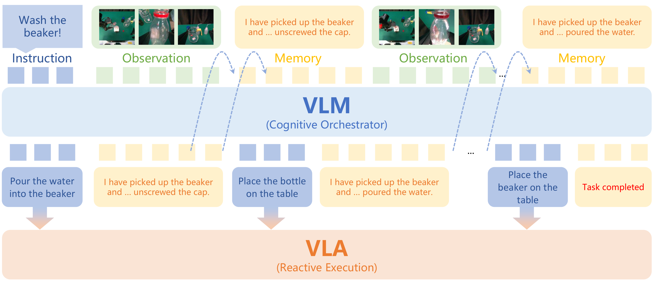
ARCHITECTURE
09
Framework overview
System-2 plans and verifies; System-1 executes; the harness keeps the two loops synchronized.
VLM
instruction + observation + memory -> current subtask
VLA
observation + executable subtask -> motor actions
Harness
skill mapping, holding, timeout recovery
Key message
Cortex is a dual-system loop with an explicitly engineered information boundary.

Slide 10
INTERFACE
10
Subtask plus semantic memory
The interface factorizes long-horizon control into immediate executable objectives and a compact task-state record.
Subtask s_t
Memory M^(t)
Factorization
Example
Definition
System-2:
[Pick] the beaker from the table
[Unscrew] the cap of the water bottle
[Pour] water into the beaker
M^(t) = M^(0) + completed milestones
Only task-relevant progress is retained.
pi_2(s_t, M^(t) | o_t, I, M^(t-1))
System-1:
pi_1(a_t | o_t, s_t)
Role
Role
Give System-1 a short, current, physically executable objective.
Prevent visual state confusion across repeated or similar subtasks.
Key message
The subtask is the immediate contract; the memory is the temporal contract.

Slide 11
EXECUTABLE SPACE
11
Canonical skill primitives and strict templates
Cortex restricts System-2 generation to commands that can be normalized for System-1 execution.
Pick
PickAndPlace
Place
Remove
Press
Push
Pull
Navigate
Fold
Wipe
Close
Open
Pour
Cut
Rotate
Handover
Sweep
Stack
Unstack
Screw
Unscrew
Scan
Aim
Clamp
Rinse
Spread
Release
Retreat
AdjustPosture
Tie
Strike
Stir
Executability
Tractability
Deployment
A generated command must map to a known skill and a known executor instruction family.
The command should include object attributes, spatial relations, counts, and reachability-aware routing.
The harness maps open surface forms to standardized System-1 labels.
Key message
A constrained skill vocabulary reduces hallucination and makes planning outputs operationally testable.

Slide 12
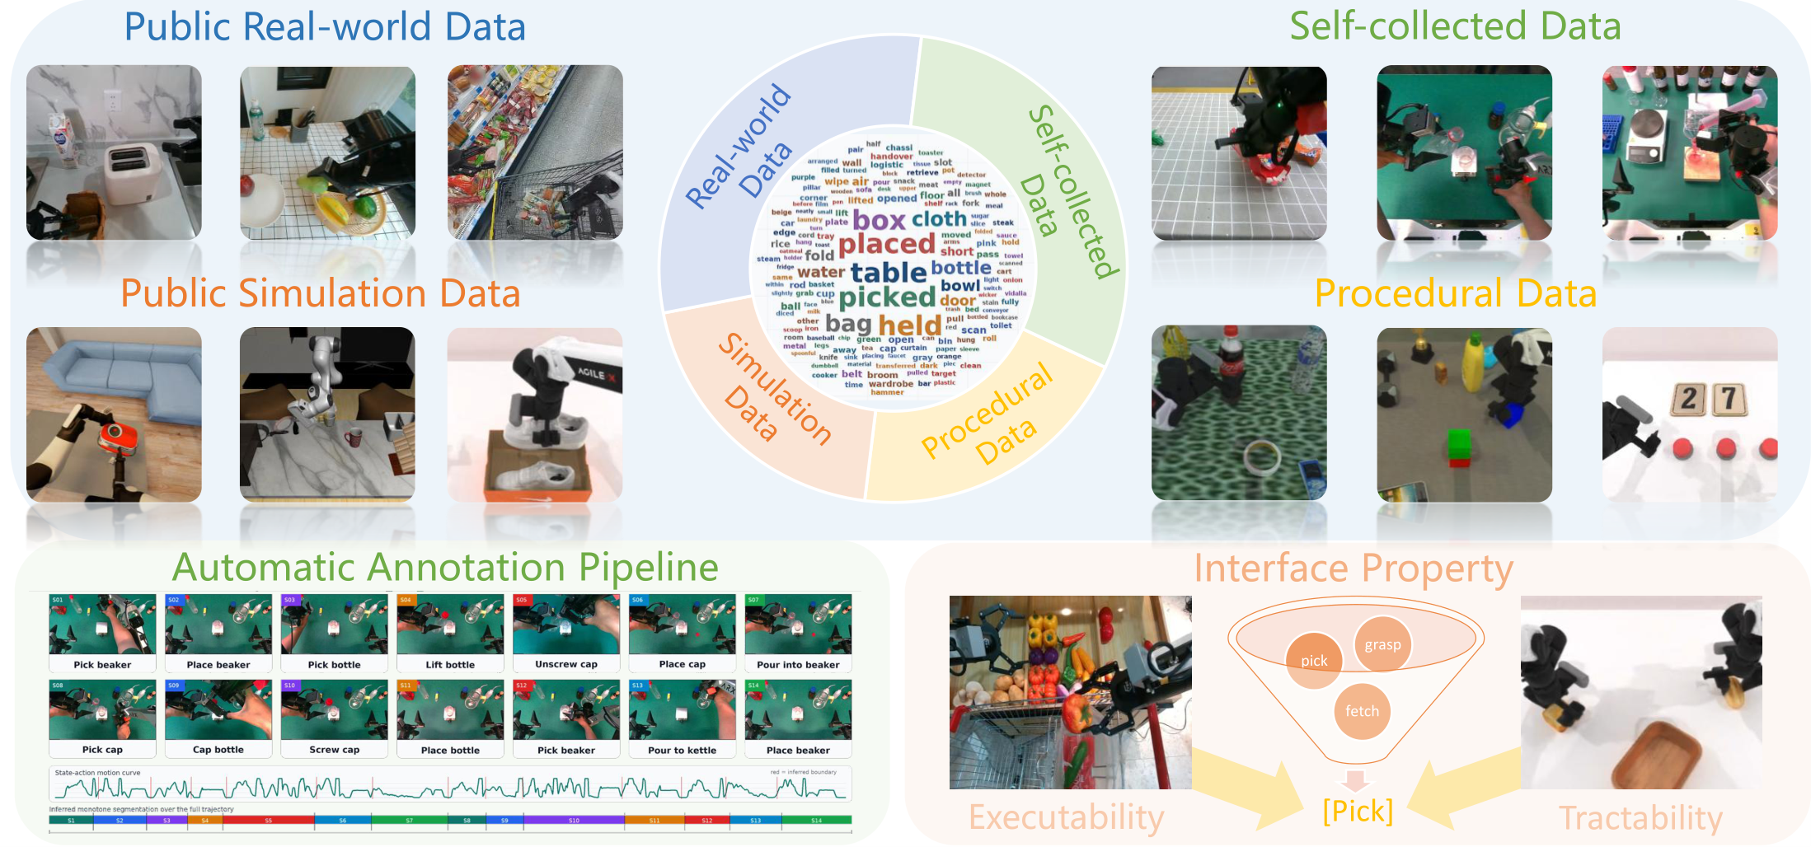
METADATA
12
Data engine for alignment supervision
The same metadata supports System-2 planning, System-2 transition verification, and System-1 subtask-conditioned execution.
4k+ h
long-horizon open-source and real-world videos
30 h
simulation data generated with structural priors
32
canonical skill primitives
>7
average subtasks per long-horizon episode
Two sources: automated annotation of heterogeneous demonstrations + procedural simulation synthesis.
Key message
Cortex treats data construction as the main mechanism for making the interface real.

Slide 13
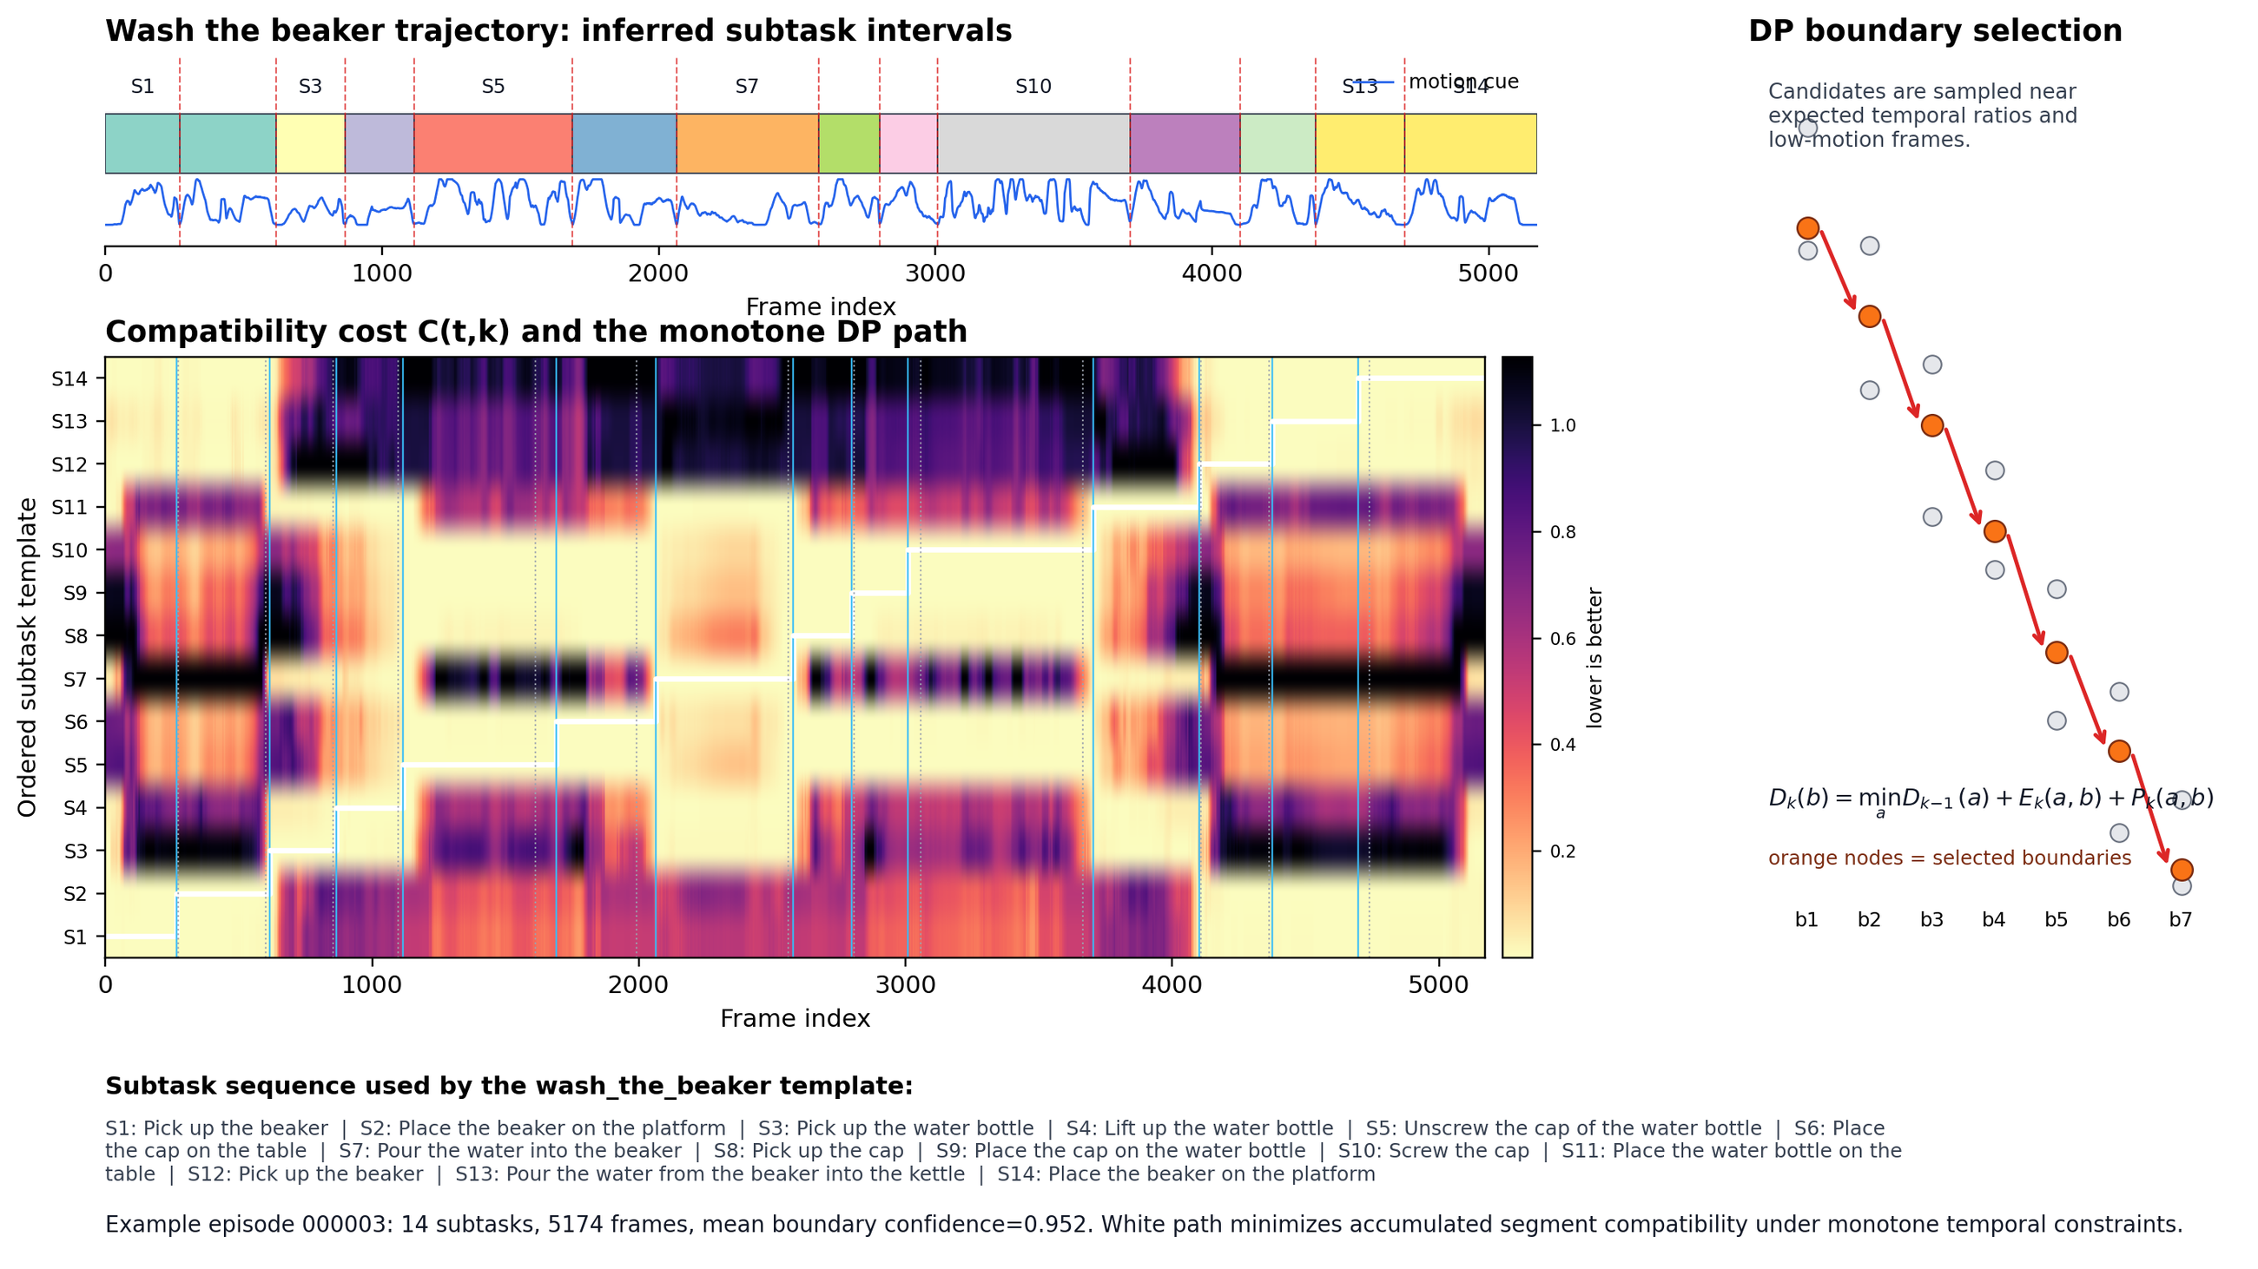
ANNOTATION
13
Automatic subtask boundary inference
Raw trajectories are converted into monotone subtask segments without dense manual frame-level labels.
Input
Raw trajectory tau = {(o_t, a_t, I_t)} and ordered task-level subtask schema S.
Features
Fuse state-action changes with visual appearance and short-term visual motion.
Dynamic programming
Infer monotone boundaries by minimizing compatibility cost, duration prior, and boundary-motion penalty.
Output
Segment spans, normalized action text, canonical skill labels, transition frames.
Key message
Boundary metadata is the bridge between task-level language and frame-level executable supervision.

Slide 14
PROCEDURAL DATA
14
Simulation generation injects tractability
Simulation lets Cortex annotate object attributes, spatial relations, counts, and reachability-aware subtask routes.
Object grounding
Interaction counts
Reachability
Simulator assets provide category, color, pose, and spatial relations. This disambiguates target objects under clutter.
Rule-based counters supervise repeated operations such as pressing buttons, moving multiple objects, or pouring in ordered stages.
Robot embodiment constraints determine optimal routes and when intermediate steps such as handover are needed.
Design principle
Generate not only semantically valid plans, but physically favorable subtask routes.
Key message
Tractability is injected before training, not patched after planning fails.

Slide 15
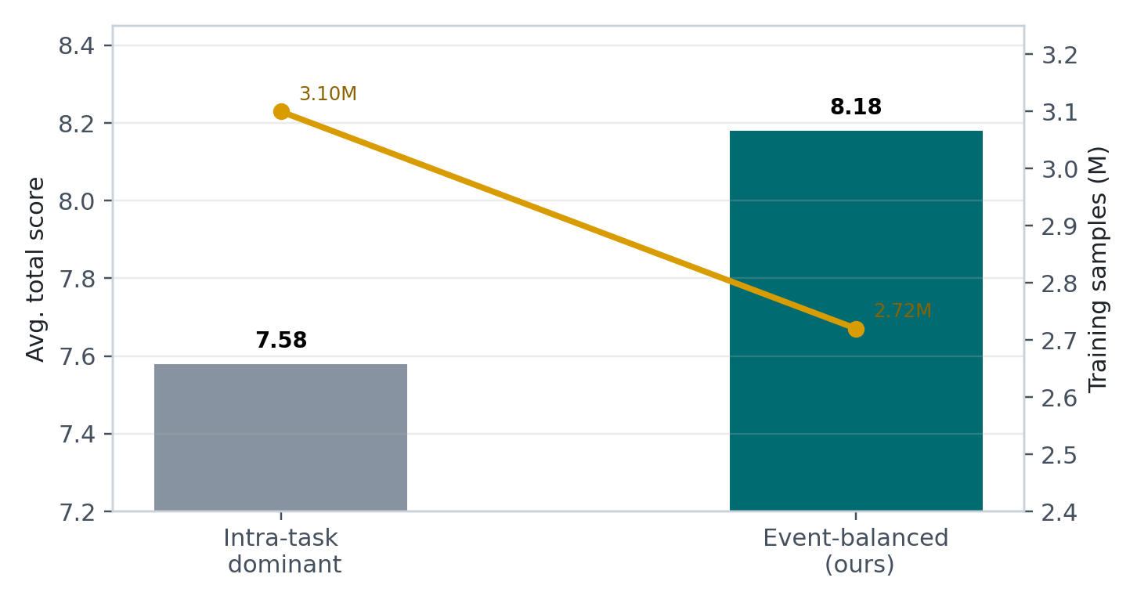
TRAINING
15
Event-balanced sampling resolves temporal ambiguity
Training must teach the orchestrator when to hold the current subtask and when to advance memory.
Boundary transition
Intra-task execution
Semantic patience
Logical advancement
If s_k is still ongoing, predict the same subtask and keep memory unchanged.
At verified boundaries, update M and generate s_{k+1}.
Galaxea ablation: event-balanced achieves 8.18 avg total with fewer samples than intra-task-dominant training.
Key message
The model learns a state machine: do not update memory without evidence; do not keep executing after completion.

Slide 16
TRAINING RECIPE
16
System-2 and System-1 are trained around the same interface
The VLM learns structured planning outputs; the VLA learns subtask-conditioned action generation.
System-2 cognitive orchestrator
System-1 reactive executor
Backbone: Qwen3-VL-8B-Instruct.
Full-parameter finetuning: vision encoder, projector, and language backbone unfrozen.
Training scale: about 14.2M effective multimodal samples.
Output format: JSON with current_skill, current_subtask, active_language_memory.
Instruction mixture: coarse goals, detailed procedures, explicit subtask lists.
Simulation executor: pi0.5-style VLA finetuned on subtask-conditioned trajectories.
Real-world executor: MEM-style VLA with a short visual/state memory window.
Input command is localized: e.g., 'pick up the glass beaker', not the full 14-step instruction.
This suppresses irrelevant future steps and reduces phase ambiguity.
Key message
The planner and executor are not trained independently in spirit; their language boundary is standardized.

Slide 17
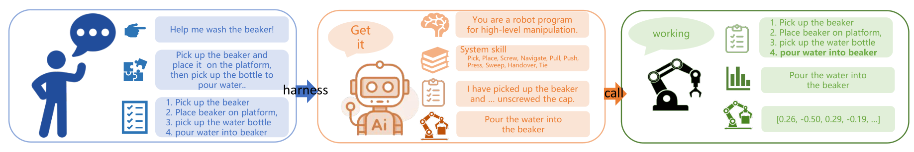
INFERENCE
17
Asynchronous deployment and harness engineering
Cortex runs low-frequency reasoning and high-frequency control without forcing either loop to block.
2 Hz System-2
Read observations and active memory; output current skill, subtask, and updated memory.
Harness
Normalize commands, enforce skill constraints, filter abnormal transitions, and hold commands.
10 Hz System-1
Execute the accepted subtask with continuous motor control.
Timeout recovery
If visual evidence is stale, apply a small reset/corrective motion to refresh observations.
Key message
The harness is the practical layer that turns open-ended VLM generation into stable robot commands.

Slide 18
EVALUATION
18
Three questions, three levels of evidence
The experiments are aligned with the design claims rather than only reporting aggregate benchmark numbers.
Q1
Open-loop VLM planning
Q2
Closed-loop simulation
Q3
Real-world deployment
Does the orchestrator produce grounded subtasks and stable memory?
Does the dual system improve long-horizon task success from raw global instructions?
Does the asynchronous loop transfer to complex physical procedures?
LLM-as-a-Judge: spatial grounding, long-horizon consistency, counting.
LIBERO-Long, RoboTwin 2.0, RMBench.
ARX ACONE chemistry, beaker washing, kitchen tasks.
Key message
The strongest evidence is triangulation: better planner outputs, better closed-loop success, and real physical recovery.

Slide 19
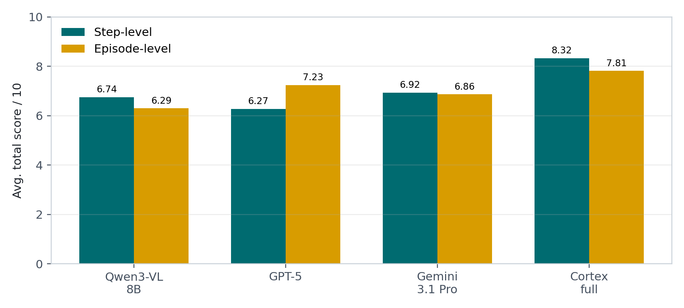
Q1 RESULTS
19
Open-loop System-2 evaluation
Cortex full harness outperforms generalist VLM baselines in both teacher-forced and self-forced settings.
Step-level
Teacher-forced memory isolates per-step generation. Cortex full harness: 8.318 / 10.
Episode-level
Autoregressive memory stresses compounding semantic drift. Cortex full harness: 7.810 / 10.
Component trend
Adding interface information and harness constraints gives consistent gains.
Key message
The VLM is evaluated as a robot state machine, not as a free-form captioner.

Slide 20
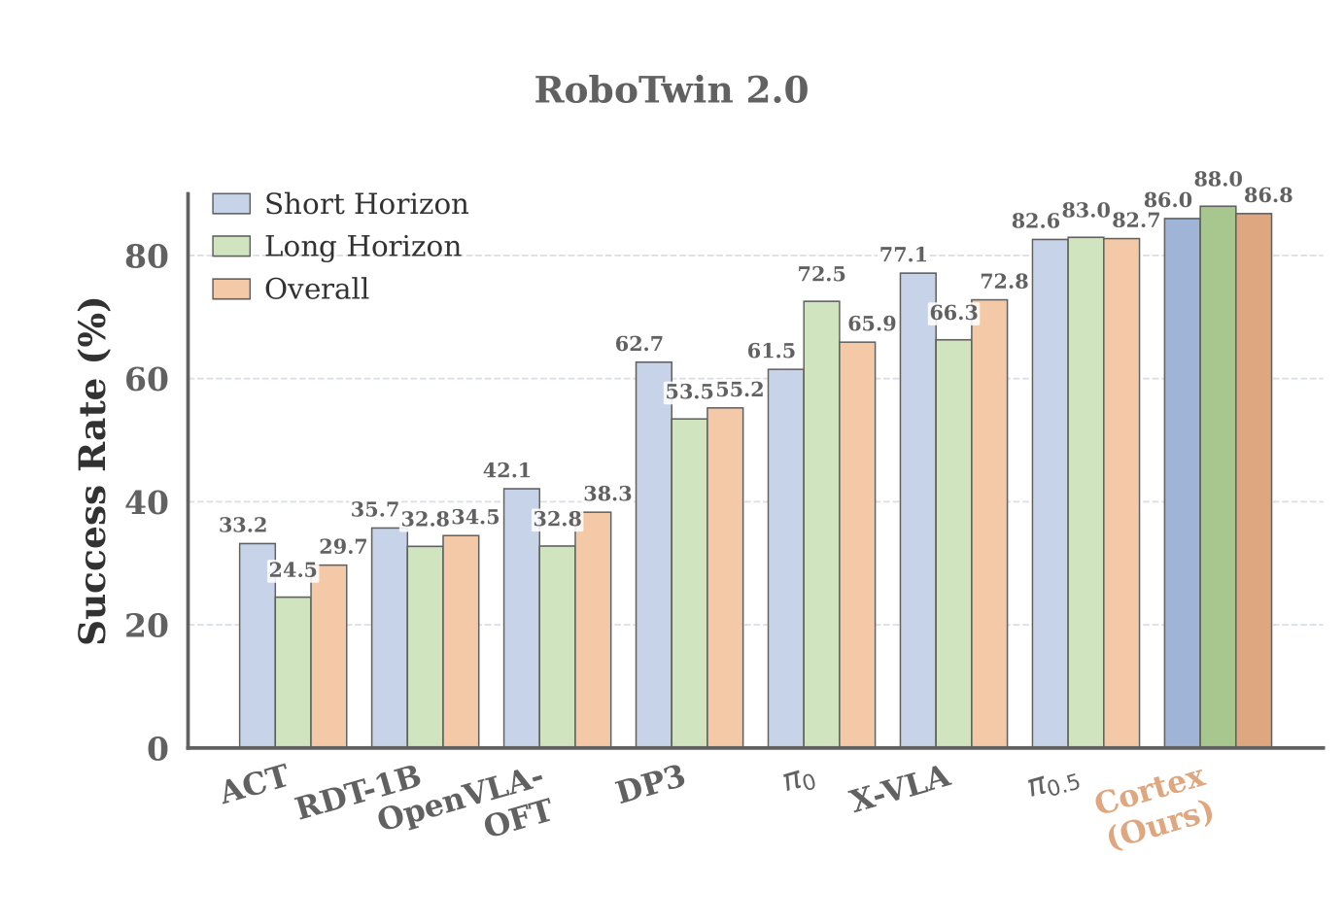
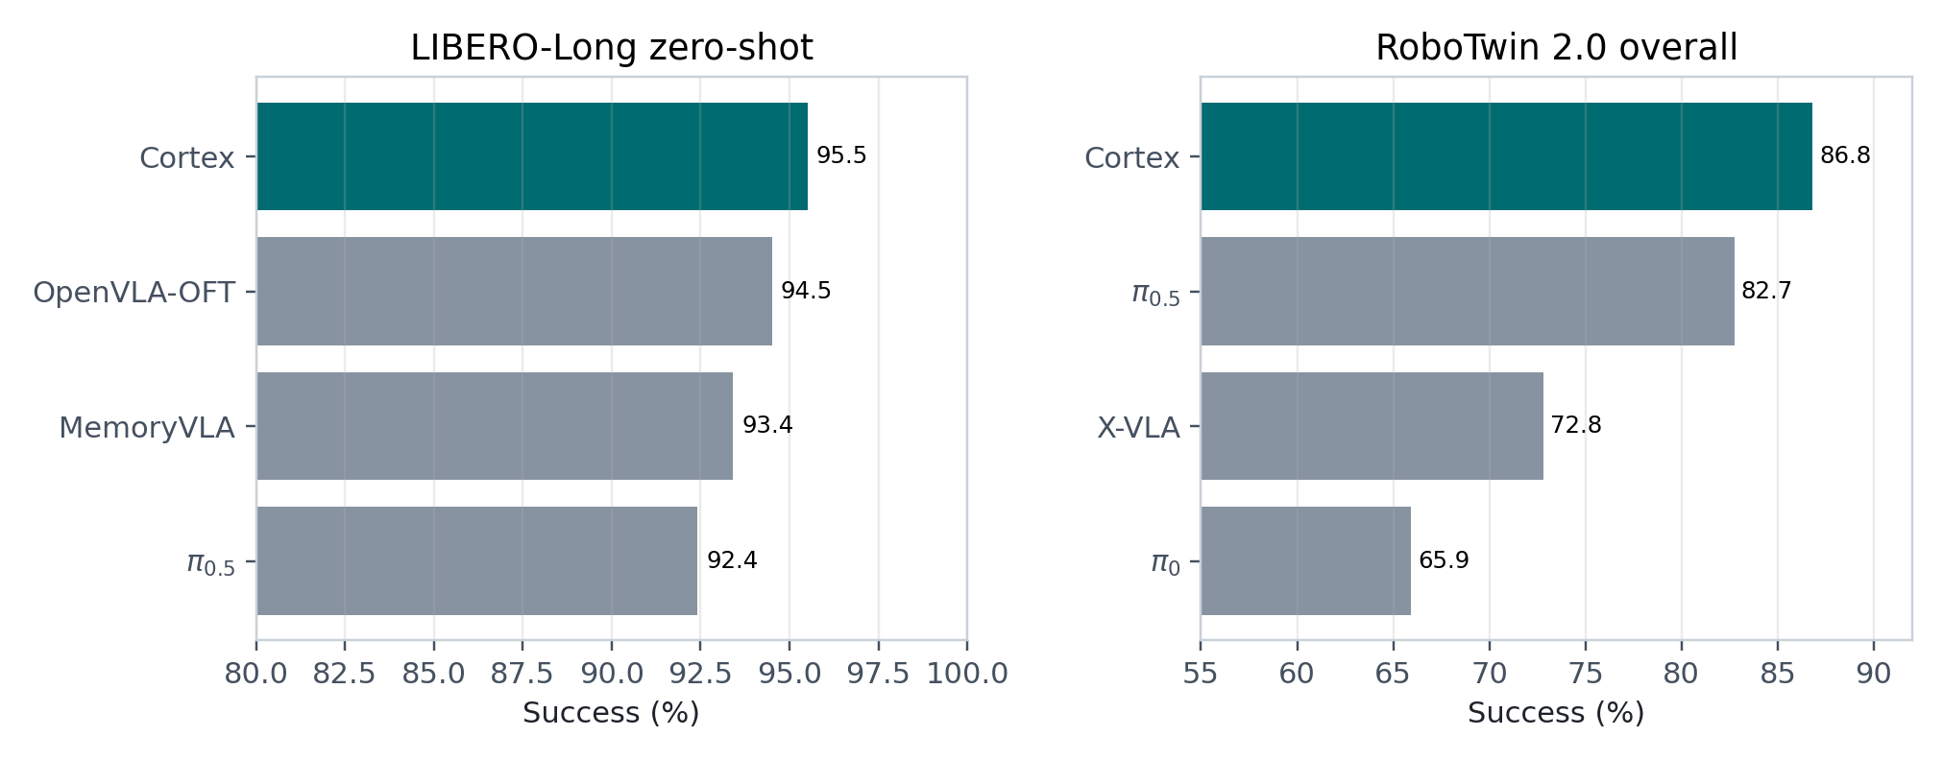
Q2 RESULTS
20
Closed-loop simulation
All closed-loop rollouts are conditioned on raw high-level global instructions rather than ground-truth subtasks.
LIBERO-Long
95.5% success; +3.1 over pi0.5
RoboTwin
86.8% overall; 88.0% long-horizon split
RMBench
Strong gains on memory-dependent manipulation tasks
Key message
The benefit is largest where task progress, repeated actions, and object disambiguation matter.

Slide 21
MECHANISM
21
Why Cortex improves closed-loop performance
Simulation gains are interpretable through semantic and temporal ambiguity reduction.
Semantic ambiguity
Temporal ambiguity
Fine-grained attributes reduce distractor confusion.
Spatial grounding supports arm choice and bimanual coordination.
Reachability-aware routing inserts intermediate handover subtasks when needed.
Examples reported in the paper: place_object_basket 79% -> 85%; handover routing 91% -> 98%.
Event-balanced supervision densifies decision points near transitions.
The planner streams the same subtask while execution is ongoing.
Memory updates only after visual evidence supports completion.
Repeated tasks such as press_button require count/state tracking rather than image-only inference.
Key message
Cortex's improvements are explainable because the interface exposes the failure modes.

Slide 22
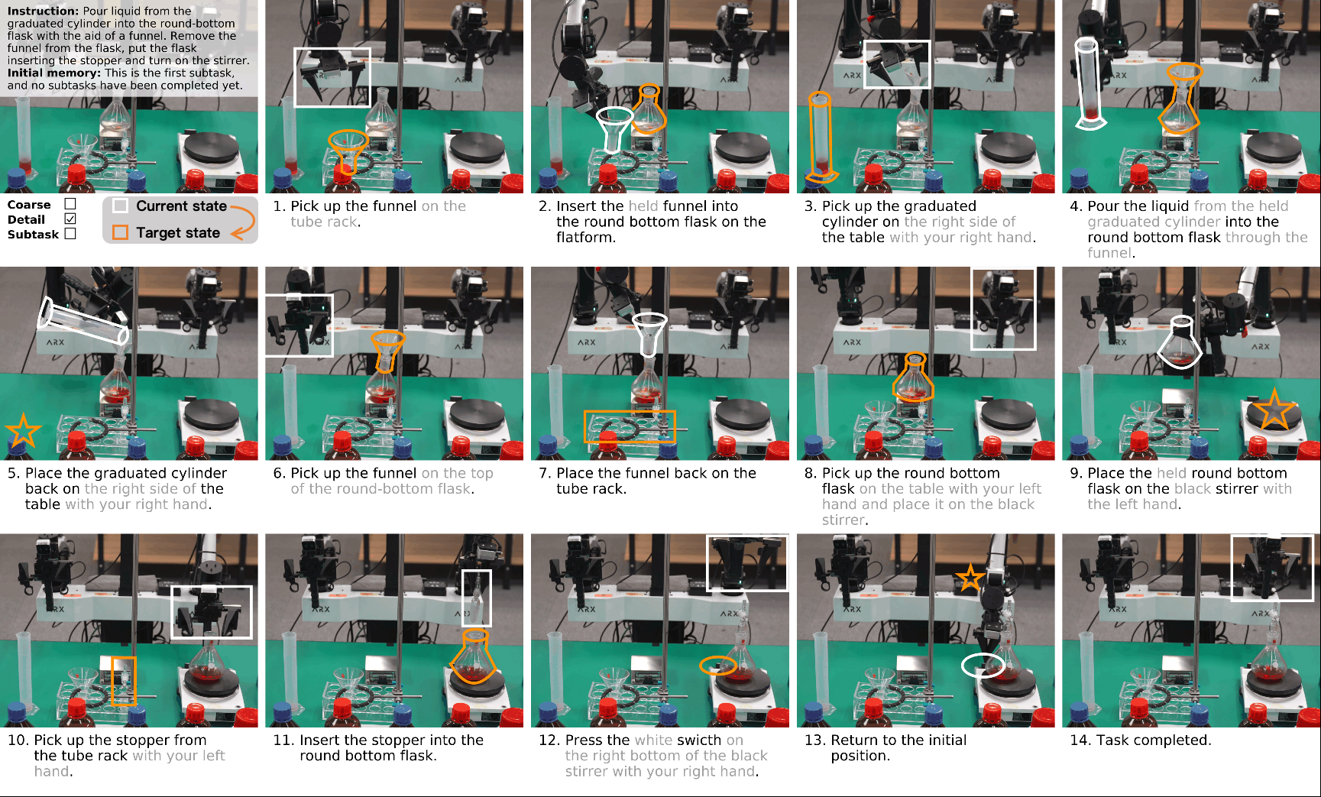
Q3 RESULTS
22
Real-world zero-shot deployment
Cortex turns a short-horizon executor into a long-horizon agent on ARX ACONE.
20 trials average
Method
Chemical
Washing
pi0.5
0% SR
2.5/14
0% SR
3.7/14
pi_mem
0% SR
4.1/14
0% SR
6.5/14
Cortex
65% SR
11.0/14
55% SR
10.5/14
Human+pi_mem_sub
75% SR
12.2/14
70% SR
11.6/14
Interpretation
End-to-end policies cannot infer global progress from raw instructions alone; Cortex dispatches verified local commands.
Key message
The real-world result demonstrates compositional long-horizon execution rather than simply better local control.

Slide 23
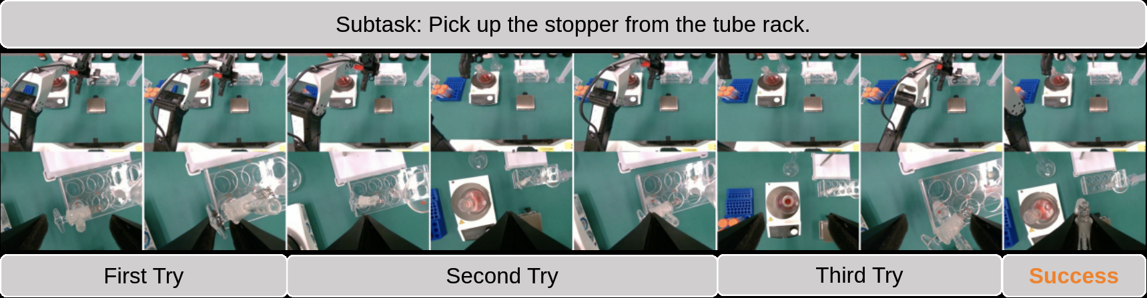
RECOVERY
23
Closed-loop physical error recovery
Cortex avoids blindly advancing when local execution fails or visual confirmation is delayed.
Failure
Stopper grasp rotates/slips under contact; the visual evidence does not support completion.
Planner behavior
System-2 preserves the current subtask and memory instead of switching to the next procedure step.
Harness behavior
Command holding and timeout-driven reset motions refresh observations without forcing task progress.
Key message
The same generative System-2 output handles planning, verification, and retry decisions.

Slide 24
LIMITATIONS
24
Where the framework still needs stronger grounding
Cortex is a scalable step toward long-horizon autonomy, but it exposes clear next problems.
Text memory
High-frequency state
Command mapping
Compressed language memory can drop pixel-level geometry and object-instance correspondence.
Vision-only transition evidence can miss micro-state changes in contact-rich or highly dynamic tasks.
Rule-based matching is conservative but fragile for rare synonyms and complex compositional relations.
Future: visual memory retrieval and pixel-level grounding.
Future: unify proprioceptive tokens with visual state tracking.
Future: learned semantic command matcher with uncertainty.
Key message
The next frontier is richer state grounding, not abandoning the interface idea.

Slide 25
CLOSING
25
Takeaways
The broader message is about designing the boundary between reasoning and control.
Long-horizon failure is a state-machine failure.
Interfaces need physical semantics.
1
2
The robot must know whether to hold, advance, retry, or terminate.
A useful subtask must be executable by the VLA and tractable under robot kinematics.
Data and deployment are part of the method.
Cortex is modular but not loosely coupled.
3
4
Annotation, event-balanced training, and harness engineering all shape the same interface.
The modules are tied together through the standardized subtask-memory contract.
Final claim
Cortex makes long-horizon manipulation more reliable by making progress explicit, executable, and continuously verified.

Slide 26
REFERENCES
26
Primary sources used for the introduction and positioning
Short references are included here for a self-contained conference deck.
[1] Brohan et al. RT-2: Vision-Language-Action Models Transfer Web Knowledge to Robotic Control. arXiv 2023.
[2] Octo Model Team et al. Octo: An Open-Source Generalist Robot Policy. arXiv 2024.
[3] Kim et al. OpenVLA: An Open-Source Vision-Language-Action Model. arXiv 2024.
[4] Black et al. pi0: A Vision-Language-Action Flow Model for General Robot Control. arXiv 2024.
[5] Bjorck et al. GR00T N1: An Open Foundation Model for Generalist Humanoid Robots. arXiv 2025.
[6] Ahn et al. Do As I Can, Not As I Say: Grounding Language in Robotic Affordances. arXiv 2022.
[7] Liang et al. Code as Policies: Language Model Programs for Embodied Control. ICRA 2023.
[8] Shi et al. MemoryVLA: Perceptual-Cognitive Memory in VLA Models for Robotic Manipulation. arXiv 2025.
[9] Liu et al. LIBERO: Benchmarking Knowledge Transfer for Lifelong Robot Learning. NeurIPS 2023.
[10] Chen et al. RoboTwin 2.0: Scalable Data Generator and Benchmark for Bimanual Manipulation. arXiv 2025.
[11] Chen et al. RMBench: Memory-dependent Robotic Manipulation Benchmark. arXiv 2026.
[12] Li et al. BEHAVIOR-1K: A Benchmark for Embodied AI with 1,000 Everyday Activities. CoRL 2023.
Cortex paper assets and reported numbers come from the local CoRL 2026 submission files in this workspace.

